Slide 1
Gradient descent
Name: Jimita Gandhi

Slide 2
Gradient Descent
Gradient descent is an optimization algorithm used to minimize some function by iteratively moving in the direction of steepest descent as defined by the negative of the gradient.
In machine learning, we use gradient descent to update the parameters of our model

Slide 3
Observation Table
EPOCHS | WEIGHT | BIAS | APPROX. ERROR
1000 | 1.79 | 2 | 2.347
100 | 1.79 | 2 | 0.0007
10 | 1.79 | 2 | 0.41
15-20 | 1.79 | 2 | 0.41
20 | 0 | 0 | 0.4149

Slide 4
Conclusion
The number of iteration increase, the error will also increase because the value of error is dependent on Epochs.
The value of Weight and Bias is not that much effect on value of error.
In gradient descent model the stable minimum error we get is at iteration no 20.
That is Epoch=20
If we put any value less than 20 epochs then we get the same value of error.

Slide 5
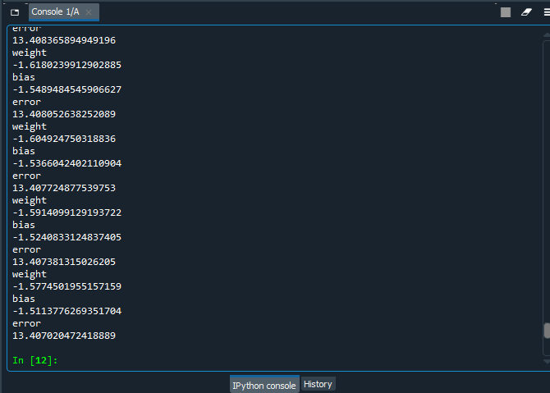
Input:- X=[0.5,2.5,5,8,9] Y=[0.2,0.9,1,3,4] Epoch=10 Output:- error = 13.415441197621941 13.415343502867628 13.415243869010803 13.415142235830357

Slide 6
Conclusion
As number of input points increase the error will increases .
Along with that the value of weight and bias also changes.

